Slide 1

Rebuking Divisions and Folly
The Hidden Depths of God Revealed
Week 54
31 May 2023

Slide 2

1 Corinthians Introduction
As we continue our study in 1st Corinthians, we are again reminded that the themes of this letter revolves around Christian Conduct in the local church and how it influences unity, discipline, and spiritual growth.
The most serious problem in the church at Corinth was worldliness -- an unwillingness to dissociate with the culture around them. So, Paul’s main objective is to make “Positional” sanctification “Progressive” in the church.
The corrective in this letter is behavior rather than doctrine, it teaches on matters of sin and righteousness, the resurrection, and answers questions addressed to Paul by the church.

Slide 3
1 Corinthians Introduction
So Paul highlights several major themes important to this ongoing process of “Sanctification.”
Unity Among Believers – focusing on Christ
Spiritual Freedom – sacrificing for weaker brethren
Holy Living – witnessing to unbelievers
Church Discipline – dealing with immorality
Proper Worship – misuse of spiritual gifts
Hope of Resurrection – misunderstandings resurrection

Slide 4
1 Corinthians Overview
These themes will be explored in our seven learning sections designed to focuses us on developing a healthy church life, addressing behavioral problems and calling Christians to sanctification and spiritual maturity.
First section (1:1-9). The Opening Prayer and Greeting, Paul extends praise and expresses his confidence that God will confirm the Corinthians faith to the end.
Second section (1:10-3:23). Paul Rebukes Divisions and Foolishness that had formed among the believers in Corinth.
Third section (4:1-6:20). Paul outlines the principles and process of church discipline needed to purge and purify the church of its Immaturity and Immorality.

Slide 5
1 Corinthians Introduction
Fourth section (7:1-10:33). To Strengthen Family and Fellowship, Paul addresses issues regarding relationships and answers the questions the church presented to him.
Fifth section (11:1-14:40). Ordering Church and Worship, Paul focuses on their self-centered approach to worship, and outlines the proper approach to living the Christian life.
Sixth section (15:1-58). Paul reiterates the message of the gospel, the person and work of Jesus Christ, and dives into the doctrine Concerning Death and Resurrection.
Seventh section (16:1-24). Paul’s Concluding Instructions and Warnings, directs proper collection for the saints in Jerusalem, and exhort them to stand firm in their faith, with love for the Lord and hope for His coming.

Slide 6
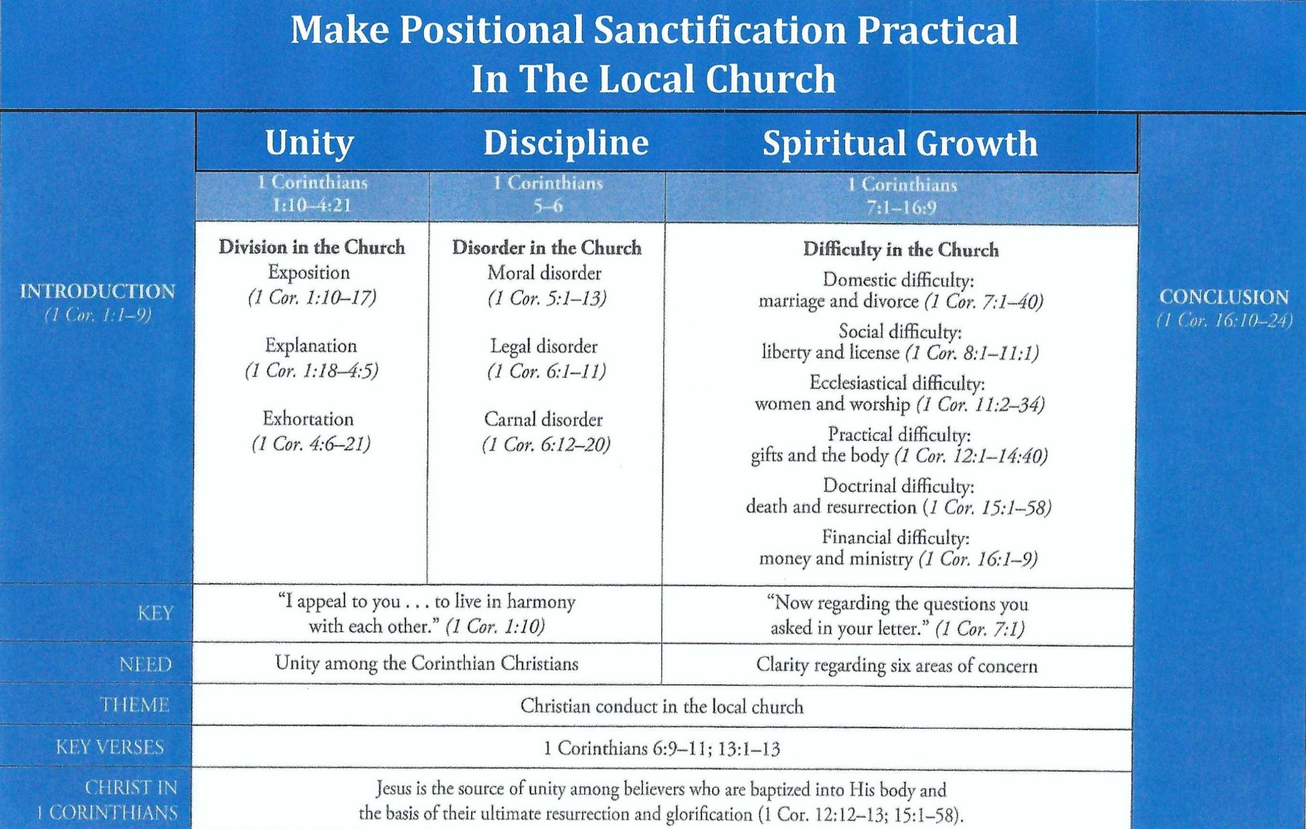
Purpose and Presentation
First Corinthians

Slide 7
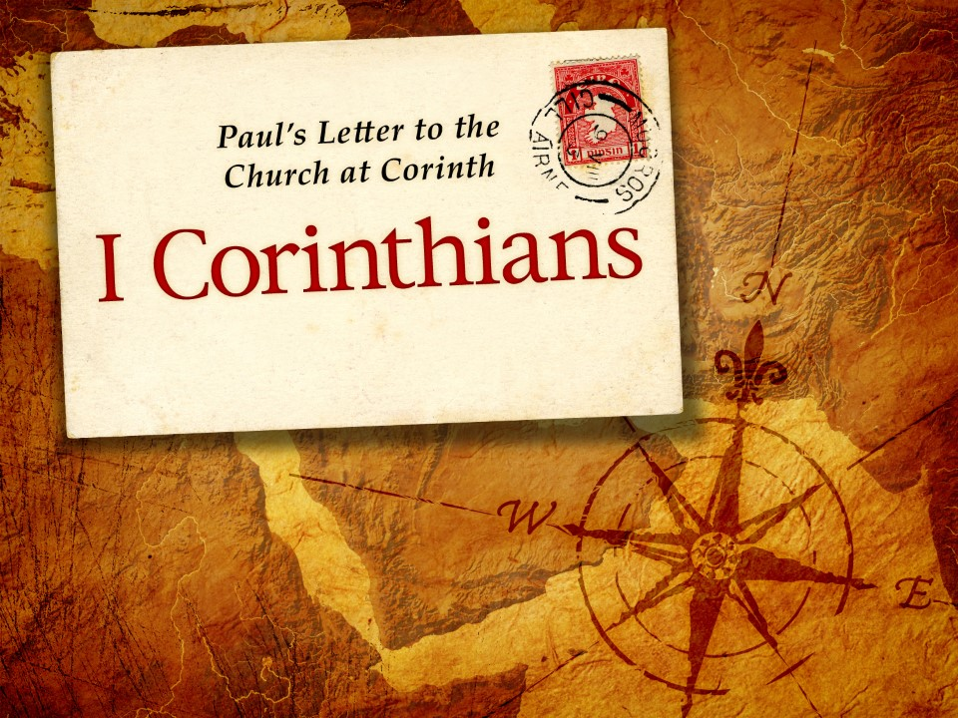
The Hidden Depths of God … Revealed 2:1-16

Slide 8
1 Corinthians - Lesson Overview
Swindoll … opens this study by reminding us of the “power” of our personal story as we share the truth of the Gospel.
“We might teach a truth from the Scripture, properly interpret a text, draw out its unchanging theology, and apply it to the lives of our listeners. We may even point to others who have lived the truth themselves.”
“Yet when a teacher’s or preacher’s own personal life is used to show how the truth of God’s Word works, people tend to listen more attentively, believe more readily, and apply the Word more eagerly.”
“Paul’s life was a testimony to God’s truth at work.”

Slide 9
1 Corinthians - Lesson Overview
After pointing out the contrast between the eloquence of worldly wisdom with its polished rhetoric and the humble, simple truth of the Christ faith . . .
Paul then reminds the Corinthians about the nature of his own apostolic ministry among them.
He doesn’t do this to point out his own strengths or to turn the spotlight on himself . . .
But, he refers to his own ministry as an example of how God uses simple means to reveal His hidden depths, and how it is the work of God’s own Spirit and not mere human intellect that reveals God’s wisdom.

Slide 10
1 Corinthians 2:1-5
¹ And I, brethren, when I came to you, did not come with excellence of speech or of wisdom declaring to you the testimony of God. ² For I determined not to know anything among you except Jesus Christ and Him crucified. ³ I was with you in weakness, in fear, and in much trembling. ⁴ And my speech and my preaching were not with persuasive words of human wisdom, but in demonstration of the Spirit and of power ⁵ that your faith should not be in the wisdom of men but in the power of God.

Slide 11
1 Corinthians 2:1-5
To understand Paul’s description of his ministry, we need to remember that he lacked nothing in educational and intellectual ability.
He had been a disciple of Gamaliel, a famous rabbi of the first century (Acts 5:34; 22:3). Beyond that, Paul could hold his own in a debate with detractors (Acts 19:8-10; 26:24-29).
So it’s not that Paul could not have come to Corinth with “superiority of speech or of wisdom” (2:1). Rather, Paul chose not to.
Why?
Because he determined to remove himself from the equation and let the spirit of God do the work of persuading.

Slide 12
1 Corinthians 2:1-5
Instead of pummeling the Corinthians with premises, syllogisms, and logical constructs, Paul presented them with “Jesus Christ, and Him crucified” (2:2). Everything else was either superfluous or worse: a distraction from the gospel itself.
So when Paul served the Corinthians, he did so “in weakness and in fear and in much trembling” (2:3). This image doesn’t match the mental picture many of us have of the courageous, “go-for-broke” apostle Paul.
Some believe that Paul was not cowering in fear of the Corinthians, but exhibiting genuine “fear and trembling” in the face of his awesome duty to conscientiously communicate the gospel of Christ to unbelievers.

Slide 13
1 Corinthians 2:1-5
Others suggest that Paul referred to his inability to measure up to the cultural expectations of a spellbinding delivery by those presenting an argument to a public audience (2Cor. 10:10).
Whatever the case, Paul embraced his calling to minister in humility and to depend on the Lord’s strength more than ever (Phil 2:12-13).
The result was staggering!
What Paul failed to exhibit in courage and talent, God more than made up in supernatural power: His grace was abundantly sufficient.

Slide 14
1 Corinthians 2:1-5
As Paul spoke with his wavering foreign accent, the gospel exploded throughout the streets of Corinth. The Holy Spirit moved into the spaces, places, building and back alleys of Corinth.
People came and listened to Paul, not because he could entertain the crowd, but because they felt drawn by the substance of the message and the powerful testimony of the accompanying miracles.
Paul didn’t try to mimic the rhetoric of the master or formulate a clever argument like the logicians. He didn’t strut. Instead, he relied entirely on “demonstration of the Spirit and the power” (2:4).

Slide 15
1 Corinthians 2:1-5
Only then could Paul ensure that the Corinthians’ faith would rest on the power of God rather than on human wisdom (2:5).
Paul was convince of a vital spiritual truth of which we need a constant reminder: Human genius and oratorical ingenuity can’t lure people into the kingdom.
Only the simplicity of the gospel, applied to the heart by the Holy Spirit, can humble people and lead them to renounce worldly ways and to embrace the Way, the Truth and the Life.

Slide 16
1 Corinthians 2:6
⁶ However, we speak wisdom among those who are mature, yet not the wisdom of this age, nor of the rulers of this age, who are coming to nothing.

Slide 17
1 Corinthians 2:6
Paul’s appeal to the cross rather than to reason and his reliance on the Spirit rather than on rhetoric didn’t go over well with most of the people in Corinth.
The dividing line began to be drawn between those who were given eyes to see and ears to hear, and those who simply could not understand the things that are discerned by the Holy Spirit.
Paul clears up the misconception that the gospel is meaningless nonsense concocted by God simply to trip up those who can’t bring themselves to make a blind leap of faith (2:6).

Slide 18
1 Corinthians 2:6
Like an iceberg that conceals its depths beneath the surface, unbelievers cannot see the hidden depths of wisdom and truth inherent in the Christian faith.
Realizing that some may interpret his disparaging of worldly wisdom as an admission that accepting the gospel requires intellectual suicide, Paul tackles the age-old conflict between faith and reason, reconciling them in the hidden depths of God.
Concluding that the wisdom spoken of in 2:6, is neither empirical fact-finding nor intuitive common sense, but insight – perception about people, problems, ourselves, and life.

Slide 19
1 Corinthians 2:6
Paul calls it “God’s wisdom,” “the thoughts of God,” “the things of the Spirit,” and “the mind of God” (2:7, 11, 14).
Only the mature in Christ can possess this wisdom, which should give spiritual babes in Christ the incentive to grow.
For the deeper we grow in the truth of God – taught not by human wisdom, but by the Spirit – the more wisdom we’ll have to grow toward spiritual maturity (Heb. 5:14 – 6:1).

Slide 20
1 Corinthians 2:7-9
⁷ But we speak the wisdom of God in a mystery, the hidden wisdom which God ordained before the ages for our glory, ⁸ which none of the rulers of this age knew; for had they known, they would not have crucified the Lord of glory. ⁹ But as it is written: “Eye has not seen, nor ear heard, Nor have entered into the heart of man The things which God has prepared for those who love Him.”

Slide 21
1 Corinthians 2:7-9
Now, Paul delves more deeply into God’s hidden wisdom, explaining why nonbelievers can see only the tip of the iceberg.
  1] The wisdom of the gospel is a mystery (2:7).
  2] The wisdom of the gospel is not understood without the spirit (2:8).
  3] The wisdom of the gospel is not discoverable by humans (2:9).

Slide 22
1 Corinthians 2:7-9
1] The wisdom of the gospel is a mystery.
Paul explains that believers “speak God’s wisdom in a mystery” (2:7).
The Greek word for “mystery” is “mystḗrion” it refers to something previously hidden that has now been revealed.
Like a secret to be shared among a select few, God has made the mystery of the gospel crystal clear to believers, the recipients of His revelation; but the gospel remains obscured to those who have not yet entered God’s inner circle.
He goes even deeper describing how the hidden wisdom of God had been “predestined before the ages to our glory.”

Slide 23
1 Corinthians 2:7-9
Here, Paul uses the same imagery in found in Eph. 1:4, where he says God “chose us in Him before the foundation of the world.”
While, the gospel of the incarnation, death, and the resurrection of Christ came in a surprising way, God had intended it long before time began.

Slide 24
1 Corinthians 2:7-9
2] The wisdom of the gospel is not understood without the spirit.
The mystery of the gospel has been made clear to believers, but the wisdom of the gospel is not understood by unbelievers (2:8).
The Greek word Paul uses for “knew” or “known” is “ginṓskō,” it refers to a knowledge born of a deep personal understanding. A depth of understanding that only comes as a gift of the Holy Spirit.
Second Corinthians says, “Even if the gospel is veiled, its veiled to those who are perishing, who the god of this world has blinded, so they might not see the light of the gospel of the glory of Christ” (2 Cor. 4:3-4).

Slide 25
1 Corinthians 2:7-9
Reminding the Corinthians of the human rulers who executed Jesus Paul says … “If they had understood it [the mystery of God], they would not have crucified the Lord of glory” (2:8).
Even through the spiritual ignorance of the unbelieving political powers, God brought to light the profound mystery of the Gospel.

Slide 26
1 Corinthians 2:7-9
3] The wisdom of the gospel is not discoverable by humans.
Revealing a mystery and discovering a mystery are two different things. God revealed to humanity what humans through their own methods and pursuits could never have discovered.
In our twenty-first century orientation many regard technology as a new equivalent to the Ten Commandments, the “seeing is believing” approach to reality makes little room for faith.
Swindoll suggest that … “A typical argument against the gospel often says something like … ‘I have never seen anyone rise from the dead, nor have I heard of anyone rising from the dead.’ Therefore, the idea that anybody has ever risen from the dead is best understood as a myth or legend.”

Slide 27
1 Corinthians 2:7-9
Anticipating objections, Paul describes the hidden mystery of the gospel from Isaiah 64:4. “Eye has not seen, nor ear heard, Nor have entered into the heart of man the things which God has prepared for those who love Him” (2:9).
What God Himself reveals in His own time cannot be discovered through human observation, investigation, intuition, or human logic.
We can spend our lives studying at the must prestigious schools, add a chain of letters after our names, travel the world over, and experience all life has to offer.
Yet, these empirical means can never discover the depths of God’s mystery which is only revealed by the Holy Spirit through faith.

Slide 28
1 Corinthians 2:10-13
¹⁰ But God has revealed them to us through His Spirit. For the Spirit searches all things, yes, the deep things of God. ¹¹ For what man knows the things of a man except the spirit of the man which is in him? Even so no one knows the things of God except the Spirit of God. ¹² Now we have received, not the spirit of the world, but the Spirit who is from God, that we might know the things that have been freely given to us by God. ¹³ These things we also speak, not in words which man’s wisdom teaches but which the Holy Spirit teaches, comparing spiritual things with spiritual.

Slide 29
1 Corinthians 2:10-13
So, if humans can’t discover the wisdom of God by human methods, understand it by human intellect, or believe it by human power.
Then how can anybody know and believe the gospel?
Paul tackles this question, in verse 10 through 13, by explaining:
The Priority of spiritual revelation (2:10).
The Process of spiritual revelation (2:10-11).
The Purpose of spiritual revelation (2:12-13).

Slide 30
1 Corinthians 2:10-13
1] The Priority of Spiritual Revelation (2:10).
God chose those who trust in Him to receive His wisdom, Paul says “God has revealed them to us through His Spirit.”
“God reveals!” His wisdom not to the world’s erudite scholars, influential leaders, nor to the super wealthy (1:27-30).
Instead, God chose to reveal himself to those who come to Him by His undeserved grace through the simple act of faith (Eph. 2:8-9).

Slide 31
1 Corinthians 2:10-13
2] The Process of Spiritual Revelation (2:10-11).
Besides the Spirit’s work in guiding believers to the truth of the gospel (John 16:8-13), the Spirit also dwells within believers from the moment they place their faith in Christ, He begins the work of transforming us into Christ’s image (John14:17; 1 Cor. 12:13; 2 Cor. 3:18).
Through the Spirit’s indwelling (Rom 8:9, 11), He searches, the “depths of God” (2:10), communicating God’s thoughts to us as we draw upon His resources. Paul argues that just as the spirit of a human knows the hidden thoughts and attitudes of that individual, so the Spirit of God knows the hidden mysteries of God.
The Holy Spirit’s role is to reveal to the believer the content of God’s mysteries.

Slide 32
1 Corinthians 2:10-13
3] The Purpose of Spiritual Revelation (2:12-13).
God gives us the Spirit who communicates the divine wisdom of Christianity to us, because we cannot understand it on our own.
The purpose of this revelation is twofold, FIRST … “that we may know the things freely given to us by God” (2:12).
SECOND … that we may “speak” (2:13) these things to others, ministering the message of the gospel through the very words God inspired (2 Tim 3:16).
These words – of Holy Scripture – are able to affect spiritual change because they are not merely human words, but words “taught by the spirit” (2:13).

Slide 33
1 Corinthians 2:10-13
Both the thoughts and words themselves are given by revelation from God (2 Pet. 1:21). God reveals the truth of the gospel by the Holy Spirit. The Holy Spirit expresses these truths in “spiritual words” not merely human expression.
Ephesian 3:9-10 says …“He allowed me to explain the way this mystery works. God, who created all things, kept it hidden in the past. He did this so that now, through the church, he could let the rulers and authorities in heaven know his infinite wisdom” (NOG).
So, when we study the words of scripture and pass them on to other, we become personally involved in God’s process of proclaiming the mystery once hidden but now revealed through the church.

Slide 34
1 Corinthians 2:14-16
¹⁴ But the natural man does not receive the things of the Spirit of God, for they are foolishness to him; nor can he know them, because they are spiritually discerned. ¹⁵ But he who is spiritual judges all things, yet he himself is rightly judged by no one. ¹⁶ For “who has known the mind of the Lord that he may instruct Him?” But we have the mind of Christ.

Slide 35
1 Corinthians 2:14-16
Though the believer, taught by the Spirit, can spend a lifetime exploring the depths of the hidden mysteries of God, that’s not so for the unbeliever whom Paul calls the “natural man” (2:14).
Such a person who does not accept the “things of the Spirit,” “the person and work of Christ,” “the meaning of the Holy Scripture,” and “how all of these relate to one’s standing before God.”
Paul calls the “natural man” as a label for the kind of worldly-minded person who functions in the realm of the world’s wisdom, demanding empirical proof at every turn, and seeking logical explanations for everything. To such a person the things of the Spirit are “foolishness.”

Slide 36
1 Corinthians 2:14-16
Without the ministry of the Holy Spirit, unbelievers will never fully grasp, truly believe, and personally experience the riches of the Spirit, for they are “spiritually appraised” (2:14).
This word “appraised” means “discerned to be true.”
Only through the eyes of faith can a person even begin to delve beneath the surface of God’s revealed Word to comprehend it hidden wisdom.
An unbeliever may “understand” the words superficially, but to embrace them, love them, believe them, and live them—that requires the miraculous illuminating work of the Holy Spirit.

Slide 37
1 Corinthians 2:14-16
The flip side of the “natural person” is the “maturing Christian,” whom Paul describe as “he who is spiritual” (2:15).
Such a person, who is gifted and guided by the Holy Spirit, operates beyond the understanding of the world’s wisdom.
By saying that a believer “is judged by no one,” Paul is not saying that Christians are beyond reproof or correction (5:1-5, 12-13; 10:15).
Rather Paul is saying, those who align themselves to the spirit’s wisdom and submit themselves to the Christian worldview fall into the same category as the gospel.

Slide 38
1 Corinthians 2:14-16
They become foolish to the eyes of the world and cannot be evaluated based on worldly reason, rhetoric, or philosophy.
To put it plainly, unbelievers will never quite “get” their believing friends and family members.
They won’t understand why they choose to live the way they do, why they sacrifice worldly pursuits, give selflessly, or serve faithfully.
Unbelievers don’t see the point of Christian virtue when there’s so much more to gain from worldly vice.
The “natural person” will never fully grasp the Spirit-led convictions of the “spiritual person.”

Slide 39
1 Corinthians 2:14-16
The reason unbeliever cannot grasp the beliefs and decisions of believers rests on the fact that believers “lifestyles” reflect the unfathomable mysteries of God and the self-denying life of the cross of Jesus.
What foolishness to the world!
A “natural person” gazing at the life of a “spiritual person” encounters in small part “the mind of the Lord,” which not mere human can know (2:16).
So when unbelievers encounter believers who have submitted to the spirit-taught wisdom, knowledge, and counsel of God, they will stand dumbfounded.
Because “we have the mind of Christ” (2:16), those without the mind of Christ will never comprehend our ways.

Slide 40
Applications
Of the
lesson
Delving into the Depths of God

Slide 41
Application – Delving into the depths of god
Swindoll closes this study with a familiar colloquialism, from the 1980’s that says “Been there, done that.” A phrase that indicate, “I’ve already done that, not interest in doing it again.”
He then says … “When it comes to studying scripture I’ve found that many Christians feel the same way: “been there, done that.” They won’t admit it, of course. They might even still read an obligatory verse or two of the Bible to get their quick “fix” for the day.
Yet many who once engaged in methodical Bible study, had read through the entire Old and New Testaments, and had memorized many passages of Scripture, sometimes place the ongoing, deep study of Scripture, low on their priority list. The reason: “Been there, done that.”

Slide 42
Application – Delving into the depths of god
Yet Paul’s words concerning the revealed mystery of God, tells us something vital about Scripture that we should never forget.
That the words of Scripture are not mere human words but words “taught by the Holy Spirit,” so the richness of their relevance for our lives is inexhaustible.
Every time we return to the pure springs of God’s infinite wisdom in Scripture, our finite cups overflow as the Holy Spirit, the author and teacher of Scripture, illumines our minds and applies to our lives just what He wants for us that hour, that day or that year.
Swindoll says … “Maybe you’ve read through the bible once or twice.”

Slide 43
Application – Delving into the depths of god
Maybe you’ve committed many verses or even a whole book to memory. Maybe you’ve studied through several books with commentaries. Great! Keep it up!
But, don’t be afraid to go deeper, by reviving the lost art of meditating on God’s Word (Josh 1:8). Meditation focuses our thoughts on a single verse or passage of Scripture for an extended period of time.
In meditation, we ponder specific truths of Scripture slowly, piece by piece, allowing our minds to dig deeper into a word, phrase, idea, or principle as the Spirit drills deep into our hearts and minds to deposit the truth permanently in our souls.
Think of meditation as “scriptural saturation.”

Slide 44
Application – Delving into the depths of god
Here are five steps to follow, as we plumb the depths of God’s mysteries in meditation using Proverbs 3:5-6.
Emphasize different words and phrase. Focus on the specific terms, “Trust in the Lord” or “Trust in the Lord with all your heart.” Think first about trusting. Then ponder the word “all,” than as you read, “do not lean on your own understanding,” call to mind the many way you plunge in and work thing out for your self.
Paraphrase the verse, making it personal. Rethink and restate the verse using your own words, for example: “Lord, you are commanding me to lean on you, turn my life over to you and stop my habit of worrying and working things our my own way.” Realize that the Spirit is speaking to you through His inspired Word.

Slide 45
Application – Delving into the depths of god
Compare the verse with other Scripture. Reflect on this in relation to two or three other passages that relate to your verse, using Bible search tools for help. Weave these other passages into your thoughts. For Prov. 3:5-6, you’ll discover that Psalm 37:4-5, or Phil 4:6-7, provide additional insight and deeper perspective.
Relate the verse to your present circumstance. If you feel worried, restless or ill at ease and you can’t seem to shake it. Try meditating, for example on, Prov. 3:5-6. As you do, keep your specific problems in mind. Ask God for insight! Identify and list your problems one-by-one. Look over them in light of the passage. Then turn your discoveries into prayer as you release to the Lord your problems and worries.

Slide 46
Application – Delving into the depths of god
Use Pray as a follow-up. Always conclude with prayer. Ask God to communicate His divine thoughts into your thoughts and to apply those thoughts in your life. Ask for strength to trust Him without worrying. Thank Him in advance for the change He will bring when you understand and faithfully follow His Word.
No spiritual Christian should ever say, “been there, done that” about meditating on God’s Word.
Why?
Because, if you have ever really experienced the depth of God’s wisdom through meditation, you’d be saying, “there now, doing it” and teaching others to do the same.

Slide 47


The Hidden Depths Of God … Revealed

Slide 48
NEXT CLASS – 14 June 2023
Book of First Corinthians
Before next class, read the below chapters in the NKJV and in one other versions of the Bible, i.e., KJV, NRSV, NIV, CEV, etc …
Chapter 3:1 – 23
“The Cure for Division!”

